Slide 1

Amazon Sales Data Analysis Report
Presentation by Kajal Raut

Slide 2
INTRODUCTION
Welcome to our Amazon Sales Data Analysis presentation. In this report, we will analyze the key metrics from Amazon Sales Data. With the help of valuable insights, we will explore the data to optimize sales strategies and to enhance the customer experiences in this growing competitive e-commerce landscape.

Slide 3
PROBLEM STATEMENT
Sales management has gained importance to meet increasing competition and the need for improved methods of distribution to reduce cost and to increase profits. Sales management today is the most important function in a commercial and business enterprise.

Slide 4
OBJECTIVE
The main objective of the project is to develop a report which contains Sales trend with respect to Yearly_wise, Month_wise, Yearly_month_wise with the help of some Data Analysis tools like Python, Tableau, etc. and find some relationships between the data in order to understand and analyze the facts.

Slide 5

Project workflow
Data Exploration and Data Cleaning with Python libraries
Data Pre-processing
Tableau Dashboard Creation
Visualizations and Insights

Slide 6












TOOLS AND TECHNOLOGIES

Slide 7
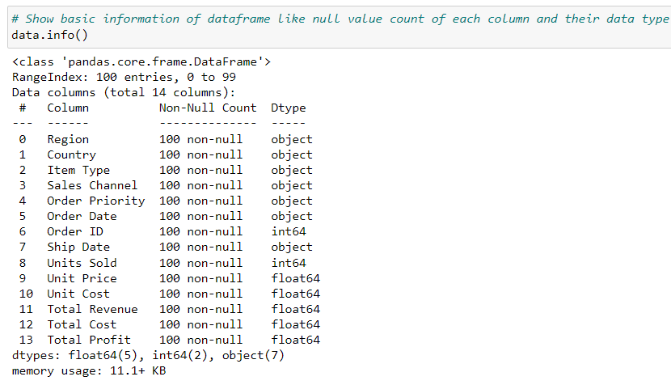
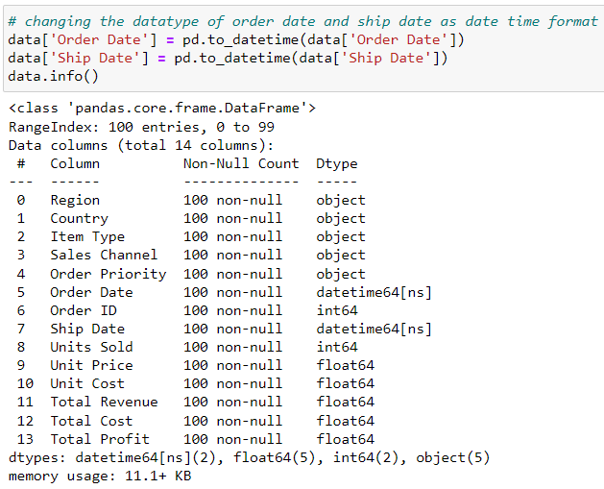
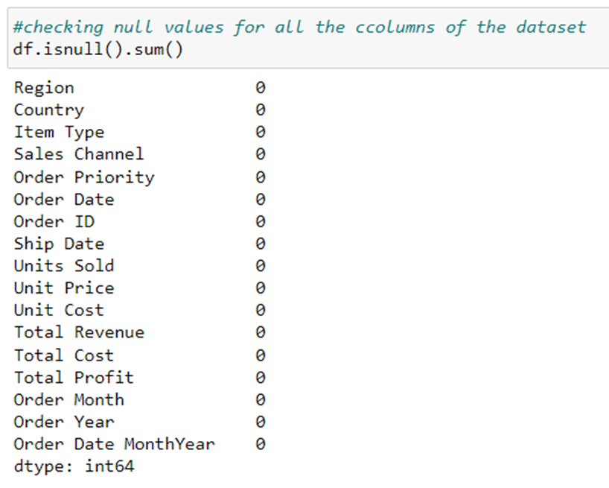
BRIEF ANALYSIS
Data Exploration and Data Cleaning with Python libraries
The Amazon Sales Data contains 100 rows and 14 columns in total. Amazon Sales Data carries the data from the year 2010 to 2017.
Converted the datatype for ‘Order date' & ‘Ship date' column into date time format.
Checked the null values for all the columns of the data set.

Slide 8
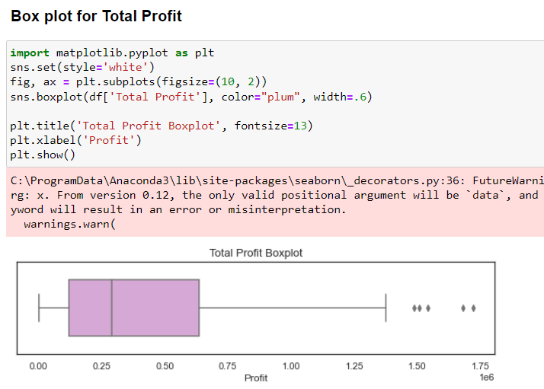
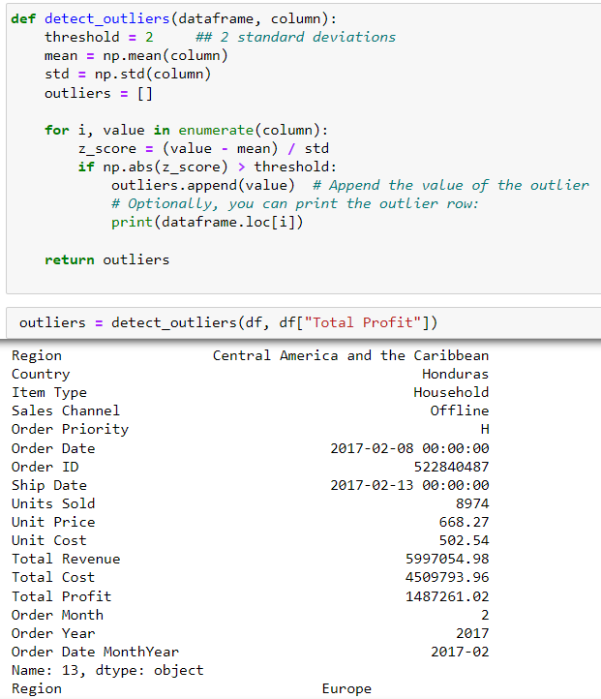

Data Pre-processing
It includes outlier detection via box plot.
Detected the outliers via boxplot and z score for Total Profit, Total Cost, Total Revenue, Unit Cost, Unit Price & Units Sold.
Maximum outliers has been found in Total Profit, Total Cost & Total Revenue columns.

Slide 9
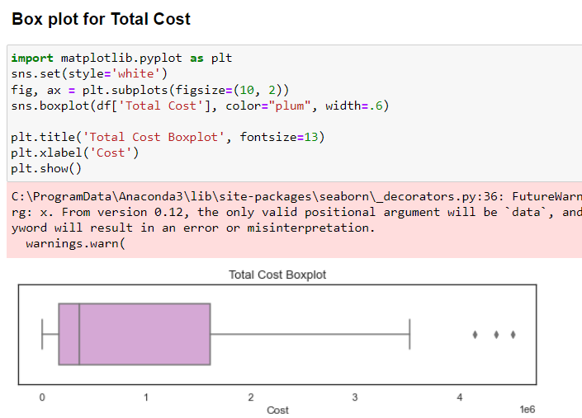
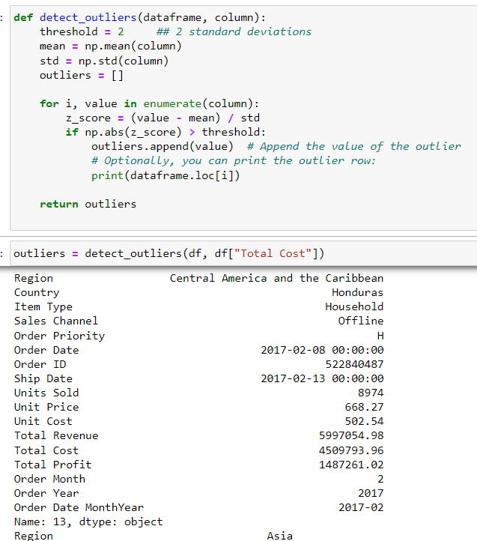

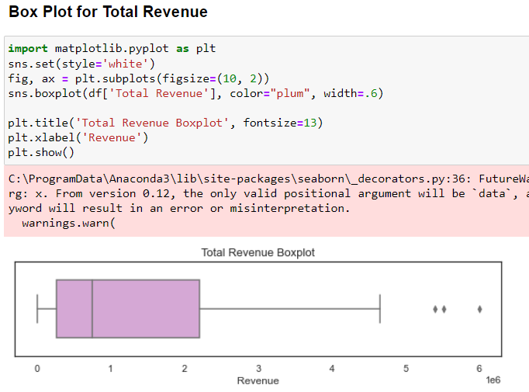
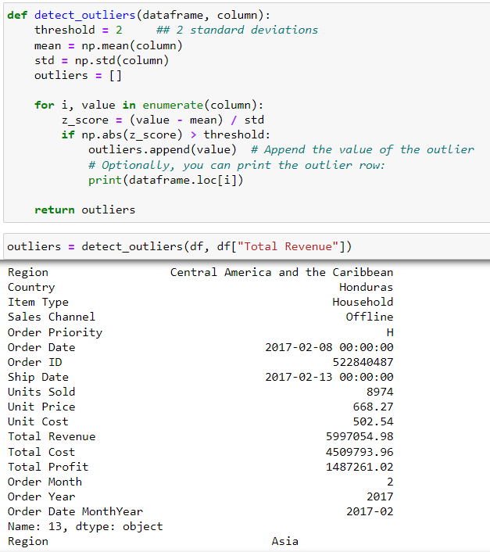

Slide 10
After detecting outliers, we visualized the plots using seaborn libraries with python. Also used Tableau to make Interactive and User friendly Dashboard, visualizing trends and patterns and also generated some insights. Let’s see how our Amazon Sales Data Dashboard works.

Slide 11
MAIN KPI’S
137M
Total Revenue
44M
Total Profit
93M
Total Cost
513K
Average Units Sold
19K
Average Units Cost

Slide 12


MY DASHBOARDS

Slide 13
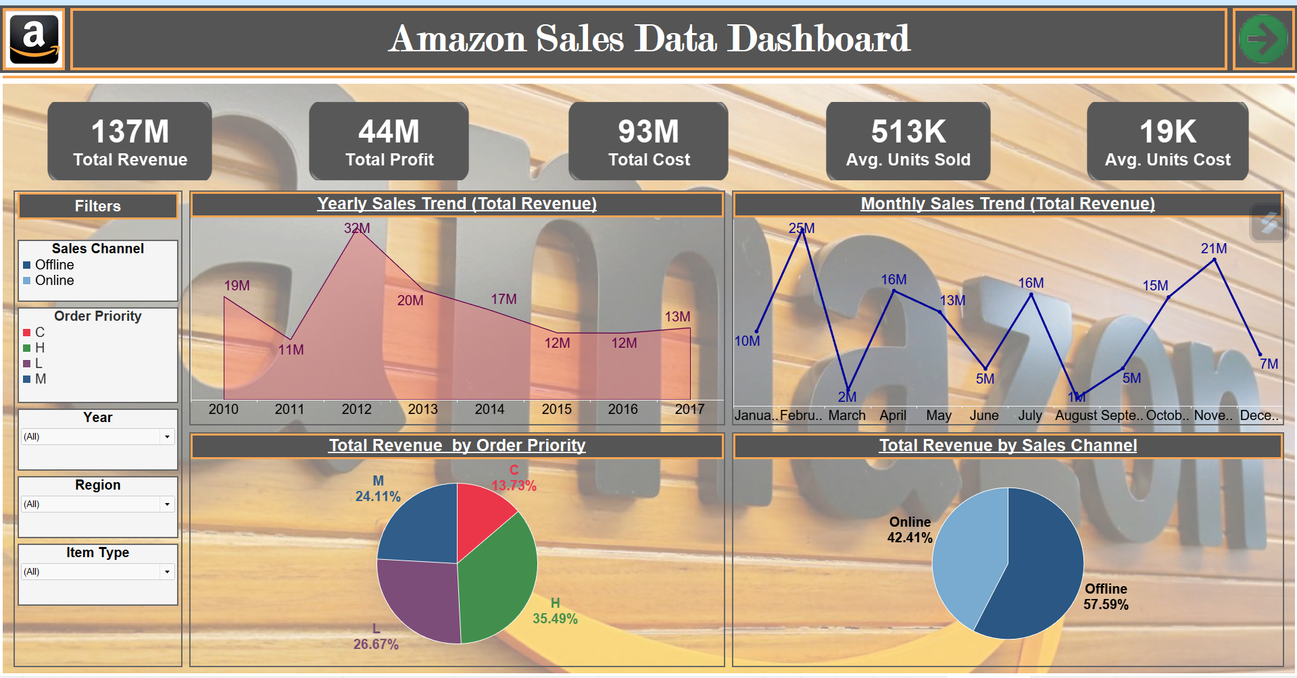
Sales analysis

Slide 14
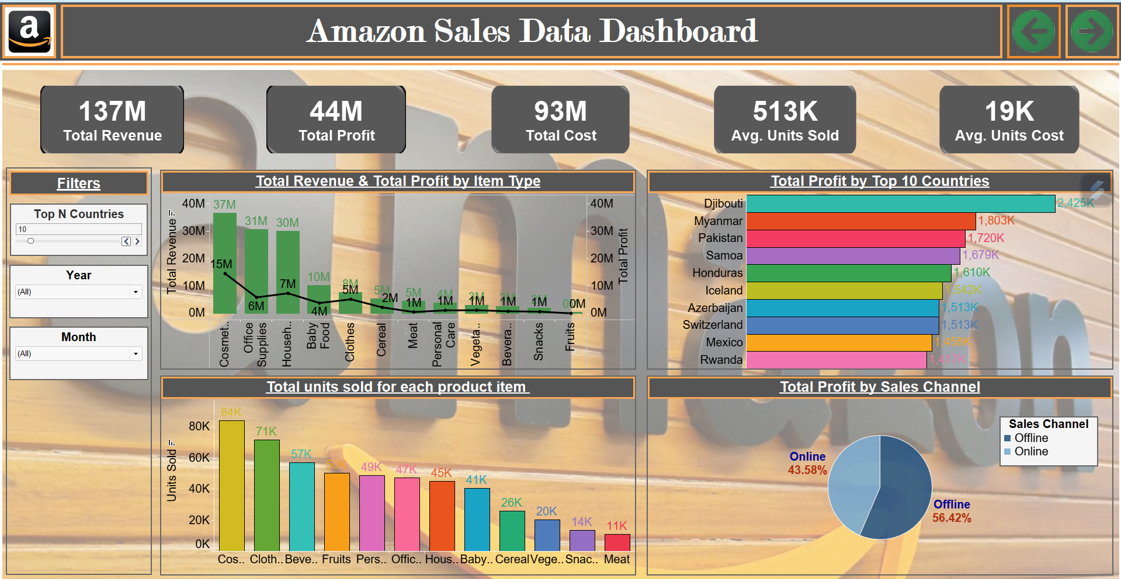
Product analysis

Slide 15
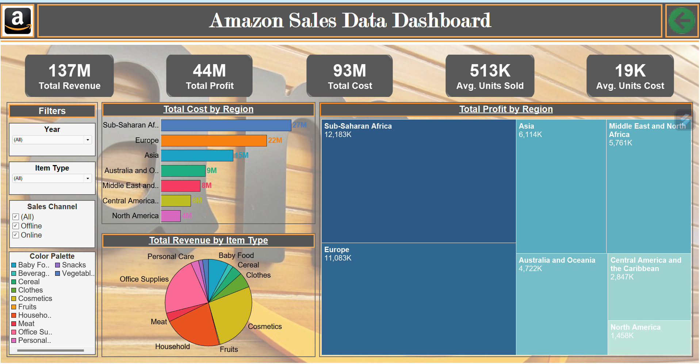
Geographic analysis

Slide 16


Visualizations and Insights

Slide 17
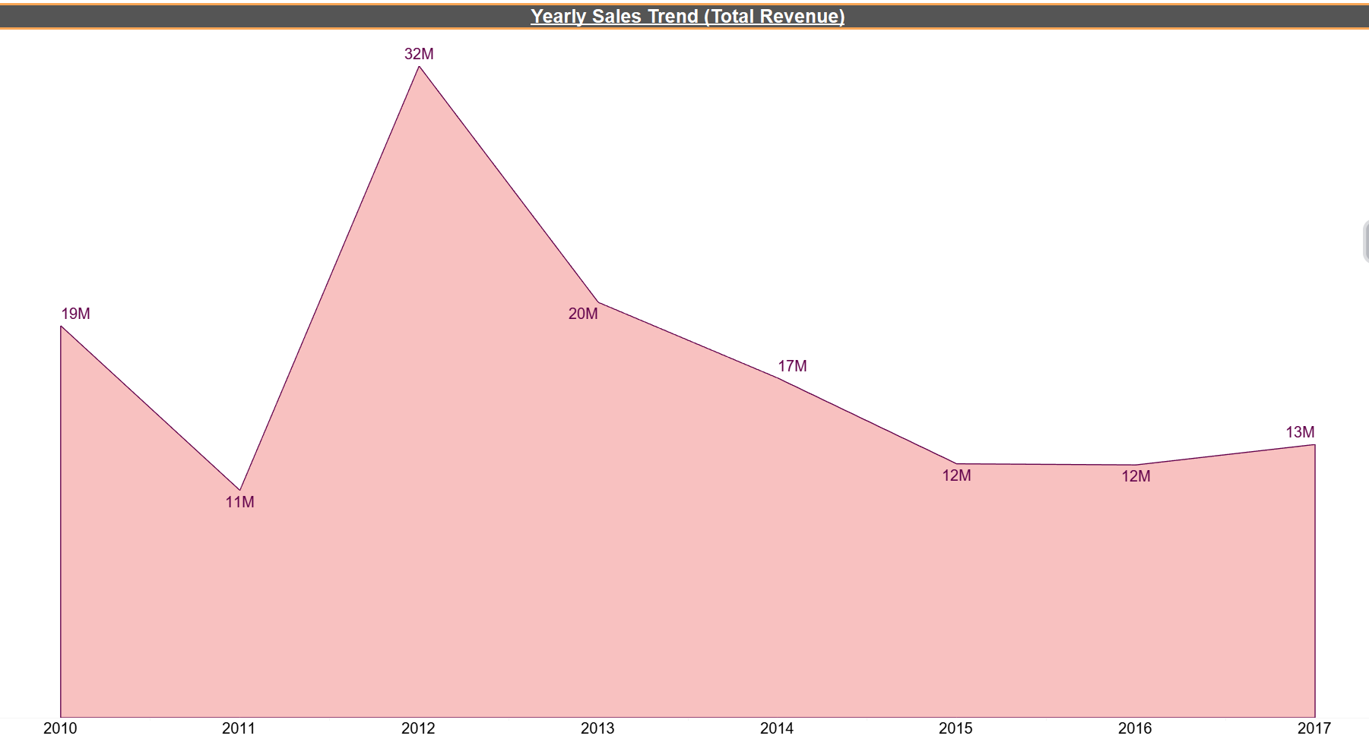

Yearly Sales Trend (Total Revenue)
Our revenue trend analysis reveals notable fluctuations over years. We can clearly see that Amazon has made the Maximum Revenue in the year 2012 with 32 million and the Minimum Revenue in 2011 with 11 million. It has been seen that there is significant increase in revenue in the year 2012 as compared to 2011 and this indicates that the year is a successful year for Amazon as the substantial growth in the sales.

Slide 18
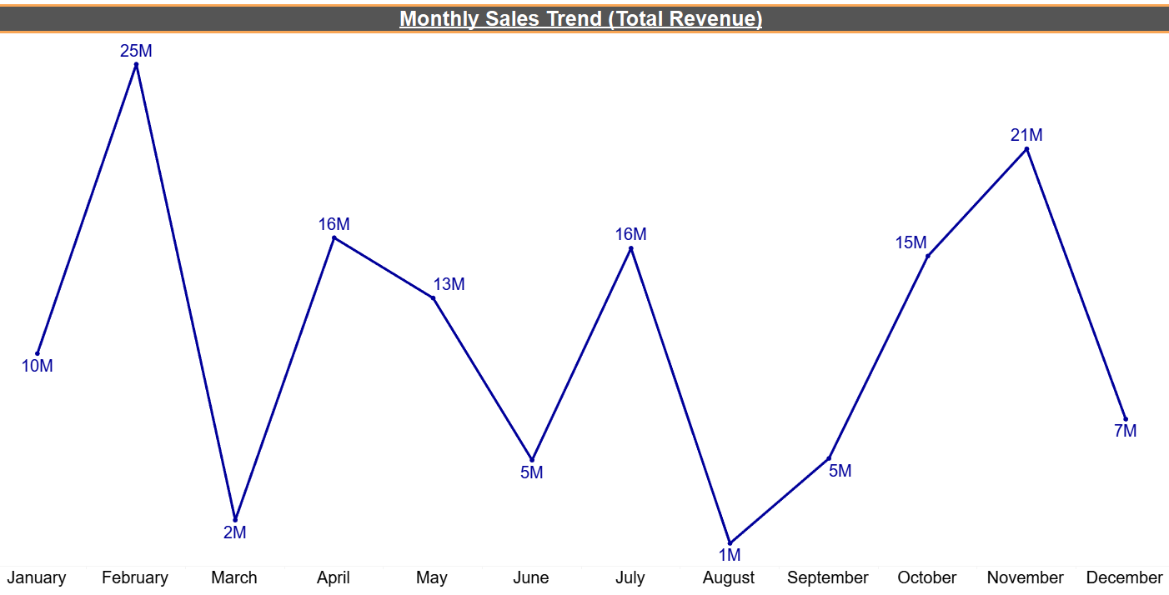
Monthly Sales Trend (Total Revenue)
Our revenue trend analysis reveals notable fluctuations over months. We can see that Amazon has made the Maximum Revenue in the month of February, followed by a steady decline from march onwards. On the other hand the Minimum Revenue made is in the month of August. However, there is a positive trend from October to December.

Slide 19
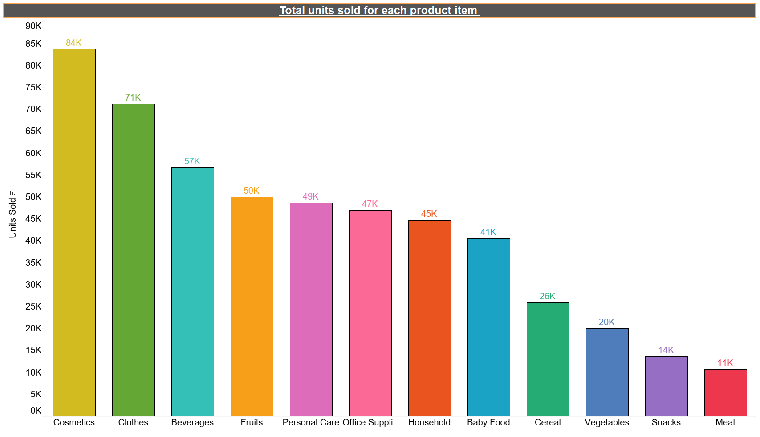
Total Units Sold For Each Product Item
The Total Units Sold for each product item shows the graph about what kind of products consumers prefers mostly. Most of the Units sold are from the Cosmetic item type followed by Clothes and Beverages. On the other hand least units sold from the item types are as Meat, Snacks and Vegetables.

Slide 20
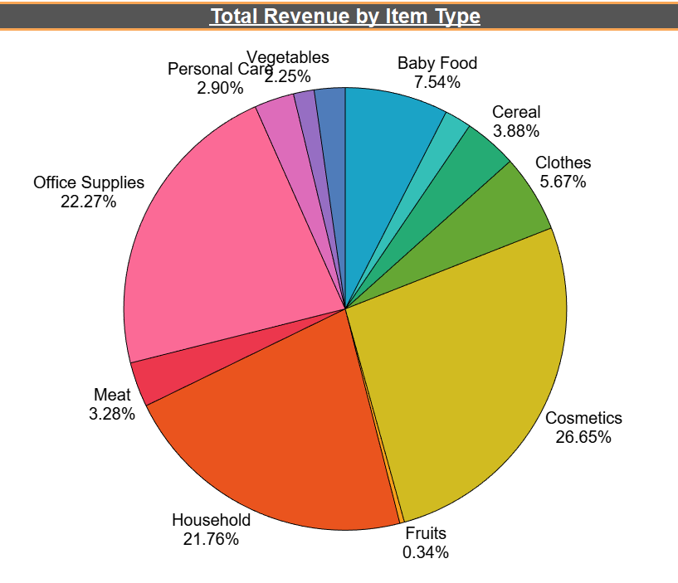
Total Revenue By Item Type
Analyzing the Total Revenue by Item Type unveils the distinctive revenue patterns. It shows the percent of total for each item. From the given figure, the maximum revenue for item type is carried by Cosmetics i.e., 26.6%, followed by Office supplies and Household with 22.27% & 21.76% respectively. Conversely, Snacks contributes the least to the amazon's revenue i.e., 1.5% .

Slide 21
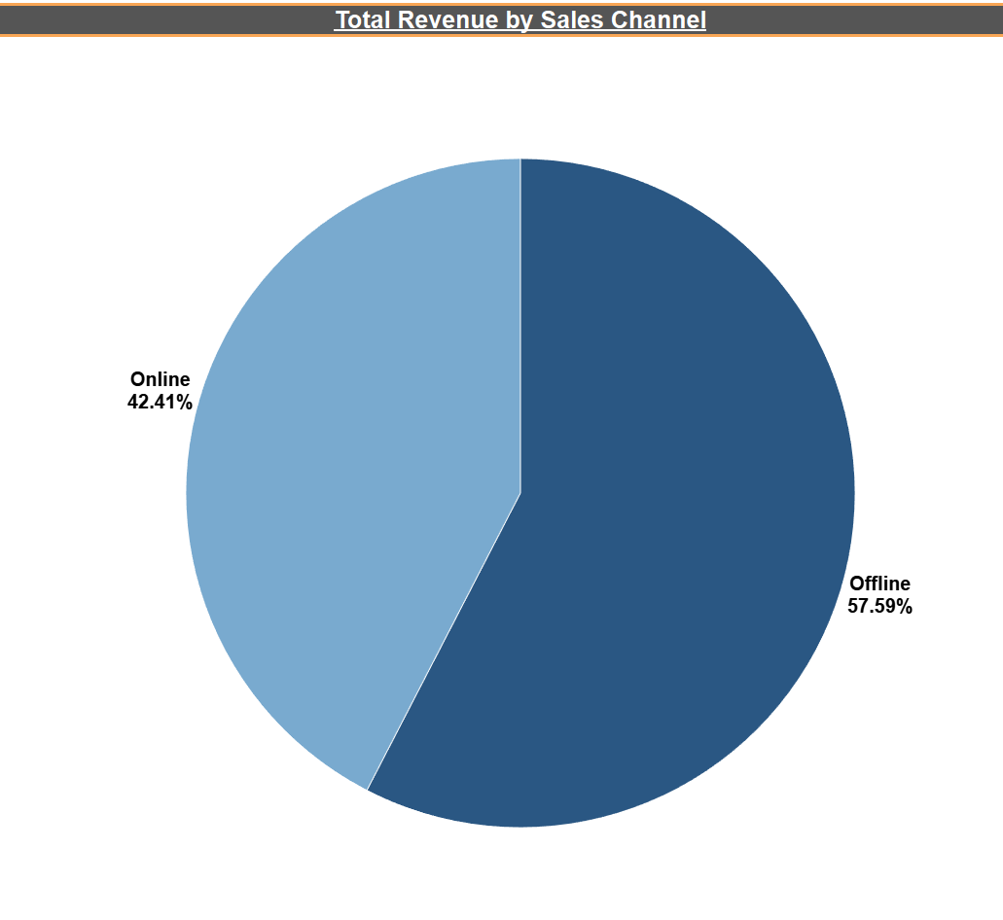
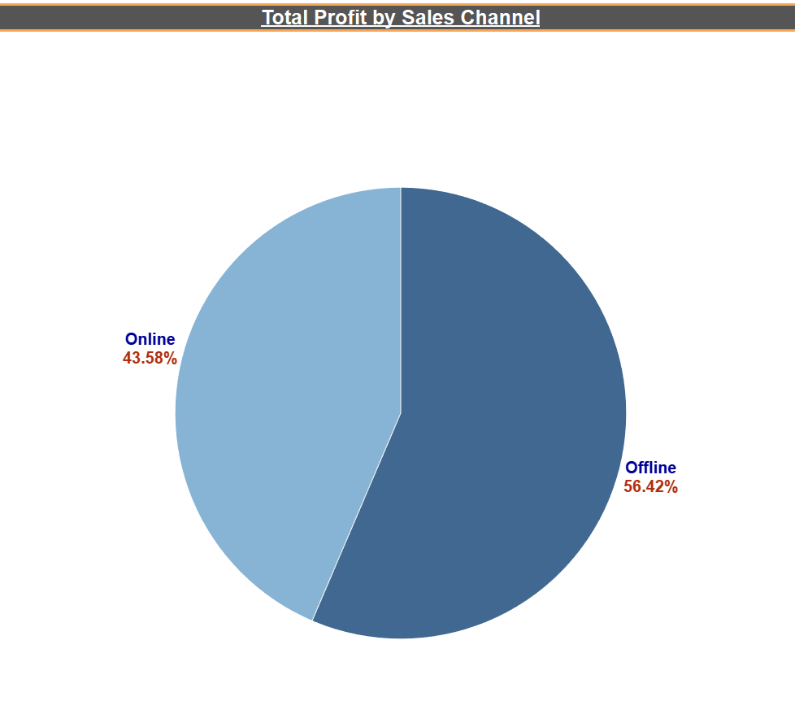
Total Revenue And Total Profit By Sales Channel
Sales channel generally shows the mode for the sales. It is seen that the Maximum percent of the Revenue is coming from Offline Channel i.e., 57.6% as compared to Online Channel.
For Profit sales chart, the sales channel mode shows the Maximum percent of the Total Profit is coming from Offline with 56.42% as compared to Online Channel.

Slide 22
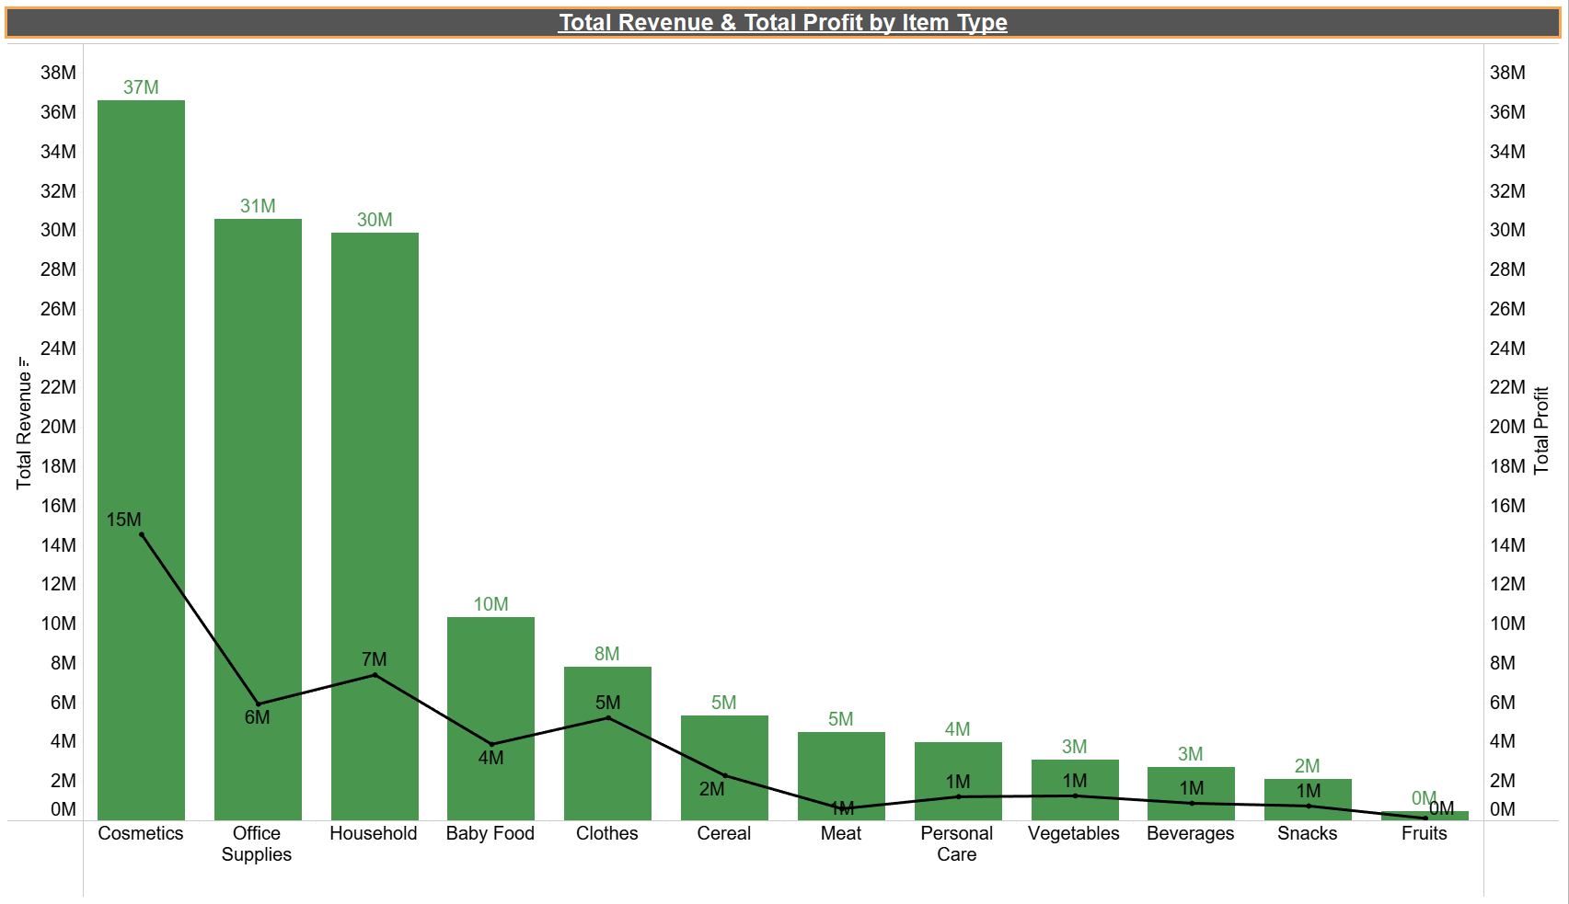
Total Revenue And Total Profit By Item Type
Total Revenue & Total Profit by Item Type analyses the revenue and profit for particular items. From the chart, the bar indicates Total Revenue & Line graph represents the Total Profit. The analysis shows the Highest Revenue for the Cosmetics product with 37 millions followed by Office supplies & Household. Similarly, Cosmetics presents Maximum profit of 15 millions. On the other hand, Fruits & Snacks represents least Total profit and Total revenue.

Slide 23
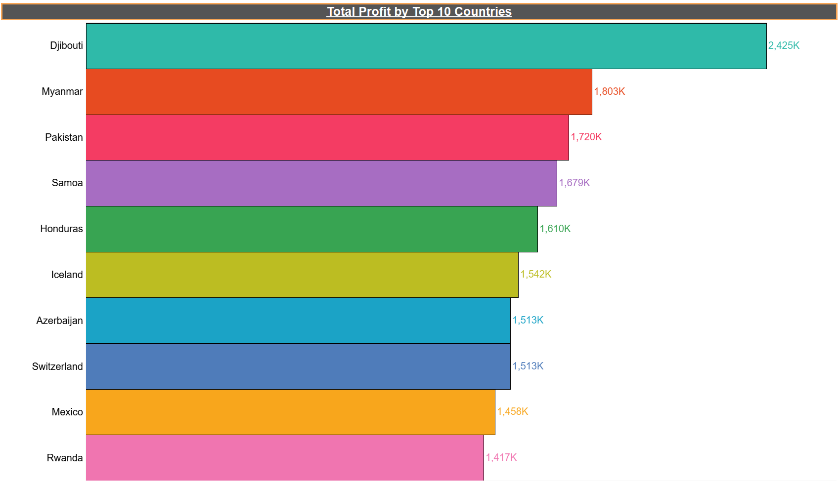
Total Profit By Top 10 Countries
In our Geographic Analysis, we delve into Country-wise Total Profit to gain insights into our profitability distribution. The graph shows the top 10 countries for the total profit. From the given graph of total profit by country, It can be seen that the country Djibouti has Highest total profit of around 2,425K following by Myanmar and Pakistan. While the countries like Rwanda, Mexico and Switzerland shows the lowest profit. It might be because of the lowest sales or least selling price of the purchases.

Slide 24
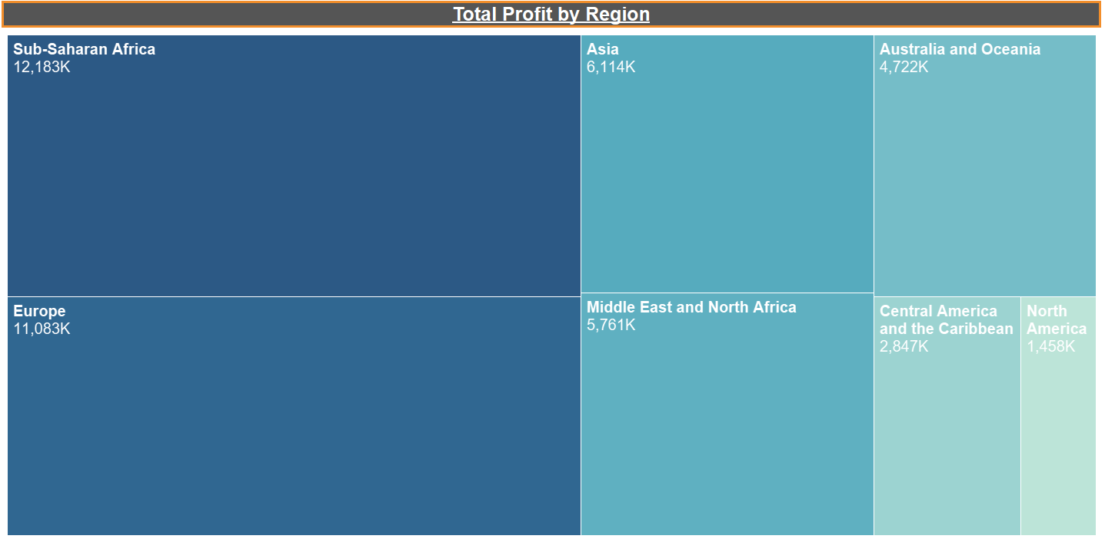
Total Profit By Region
In our Geographic Analysis, we delve into Region-wise Total profit to gain insights into our profitability distribution. The region which shows the Highest Profit is Sub-Saharan Africa having around 12,183K followed by Europe & Asia. The least contributing region is North America with 1,458K followed by Central America and the Caribbean.

Slide 25
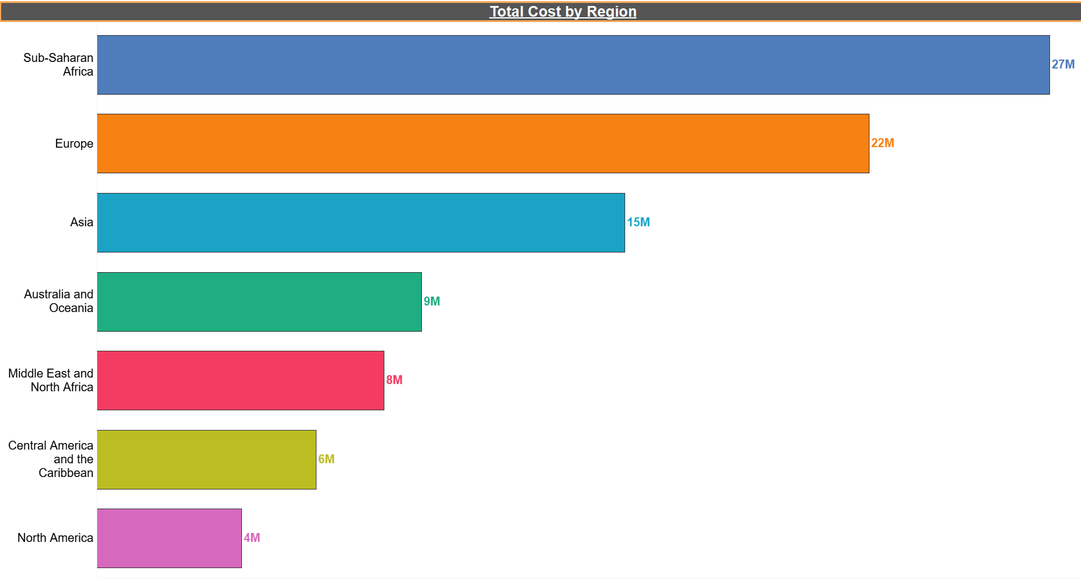
Total cost by region
In our Geographic Analysis, we delve into Region-wise Total Cost to gain insights into our cost distribution. By visualizing this graph, it shows the region which contains the Highest Cost is Sub-Saharan Africa with around 27 millions followed by Europe & Asia with 22M & 15M respectively. The least contributing Regions are North America followed by Central America & the Caribbean and Middle East & North Africa.

Slide 26
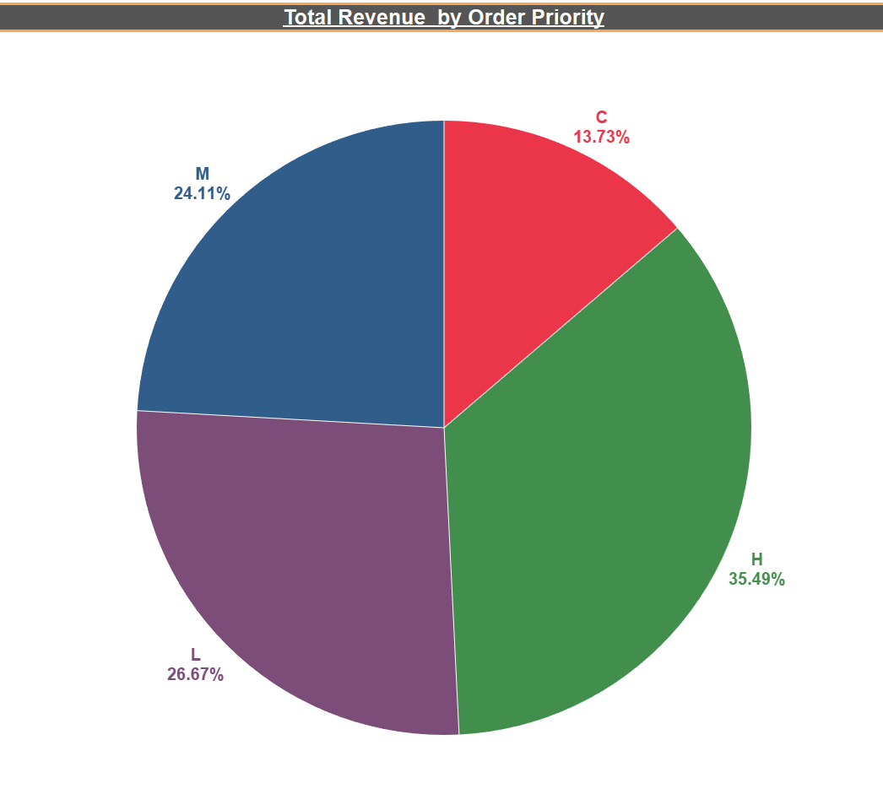
Total Revenue By Order Priority
Analyzing the Total Revenue by Order Priority unveil distinctive revenue patterns. Customers with order priority ‘H’ exhibit the Highest Revenue generation of around 35.49%, while those with priority ‘C’ demonstrate the Lowest i.e., 13.73%. This insight underscores the significance of order priority in revenue generation, providing valuable direction for resource allocation & customer segmentation strategies.

Slide 27
CONCLUSION
If we clearly observe the yearly insights, we can see that Amazon has made the Highest Revenue in the year 2012 at 32M, followed by 2013 at 20M and 2010 at 19M.
In monthly insights from 2010 to 2017, the sales are at their peak in February, April, May, July & November and are low in March, August & December.
Amazon generates the Highest Revenue from Sub-Saharan Africa and Second highest is from Europe. The least contribution for the revenue is from North America.
Cosmetics, Office Supplies & Household Items returns the most revenue to the company.

Slide 28
THANK YOU

